Slide 1
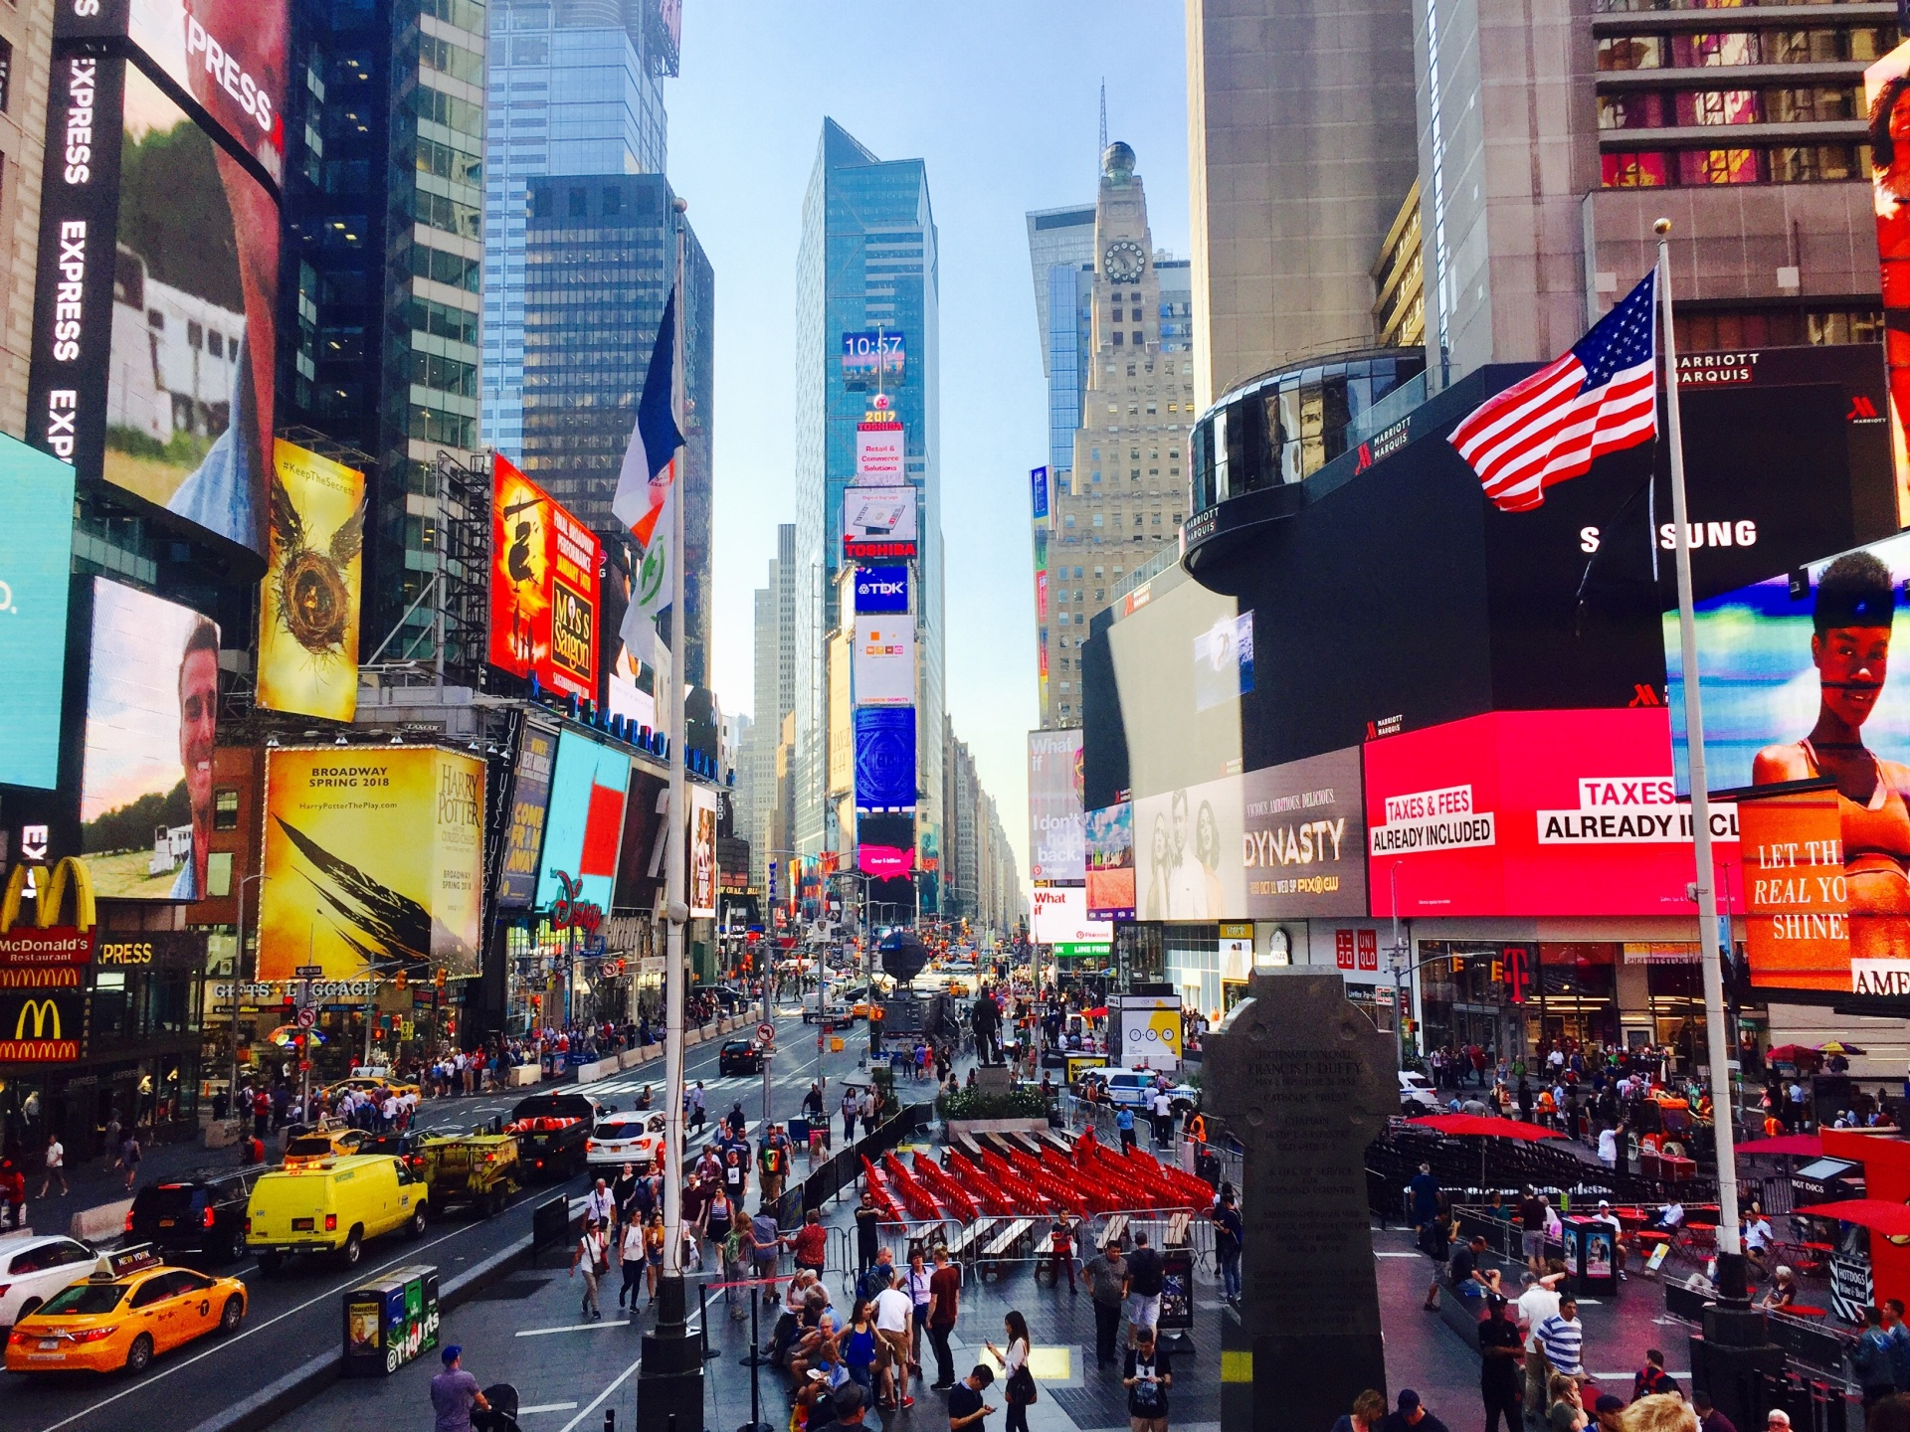
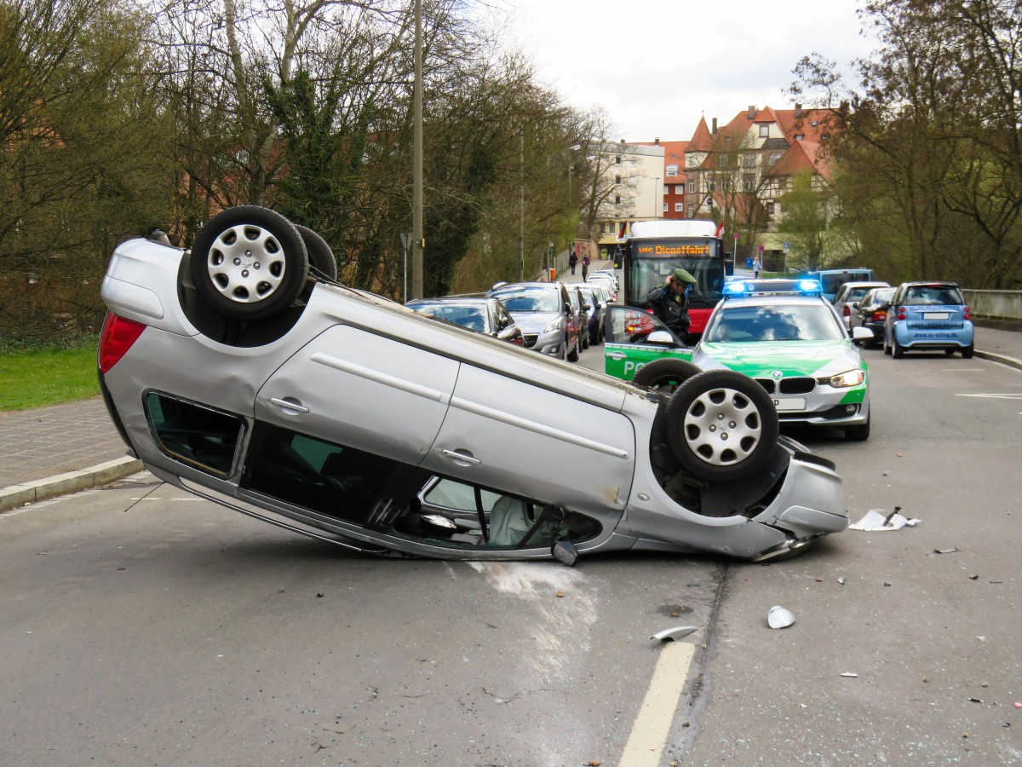
New York City Traffic Collision Analysis
Collisions from 2012 to 2023

Slide 2
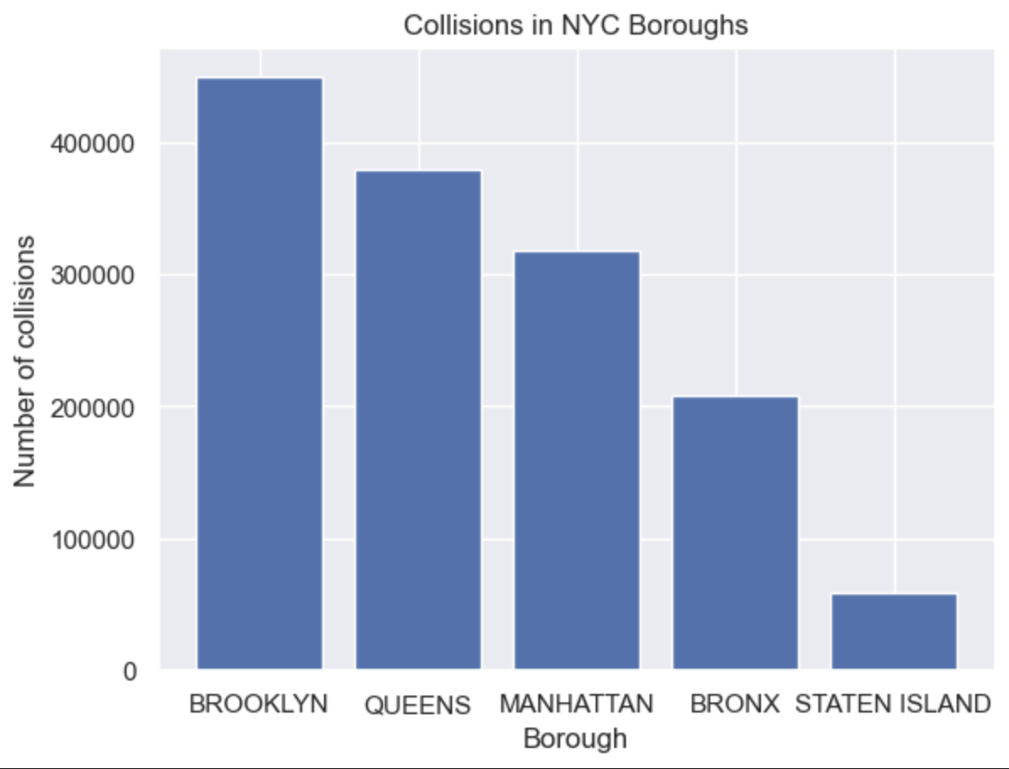
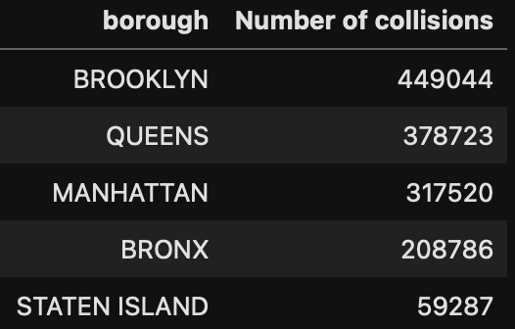
Collisions in each borough of NYC

Slide 3
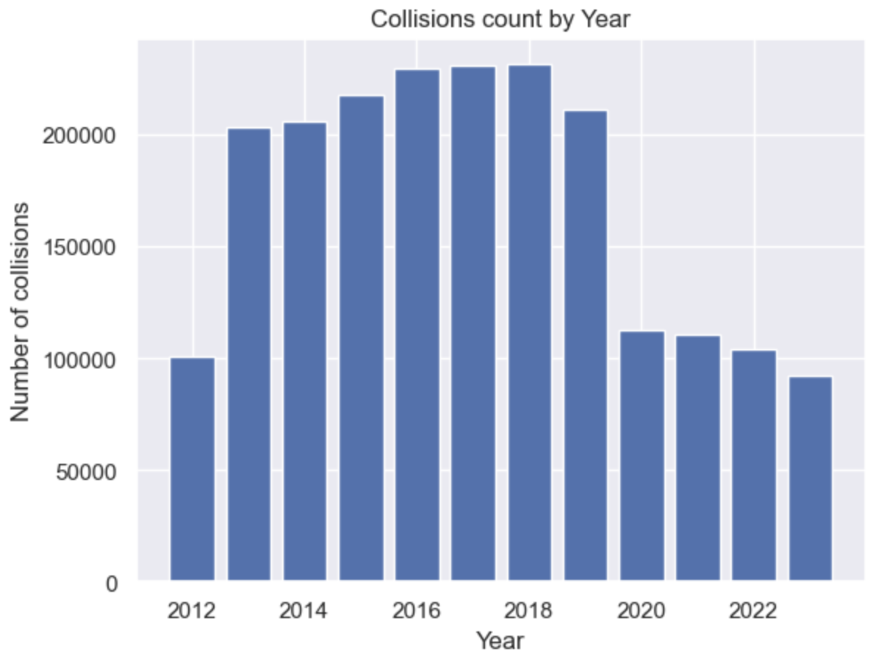
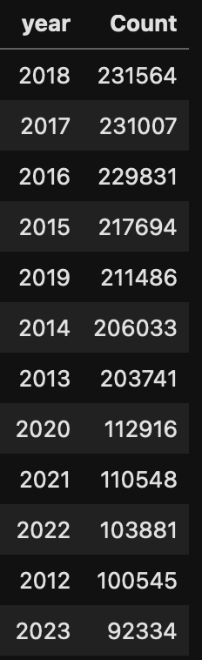
Collisions by the year

Slide 4
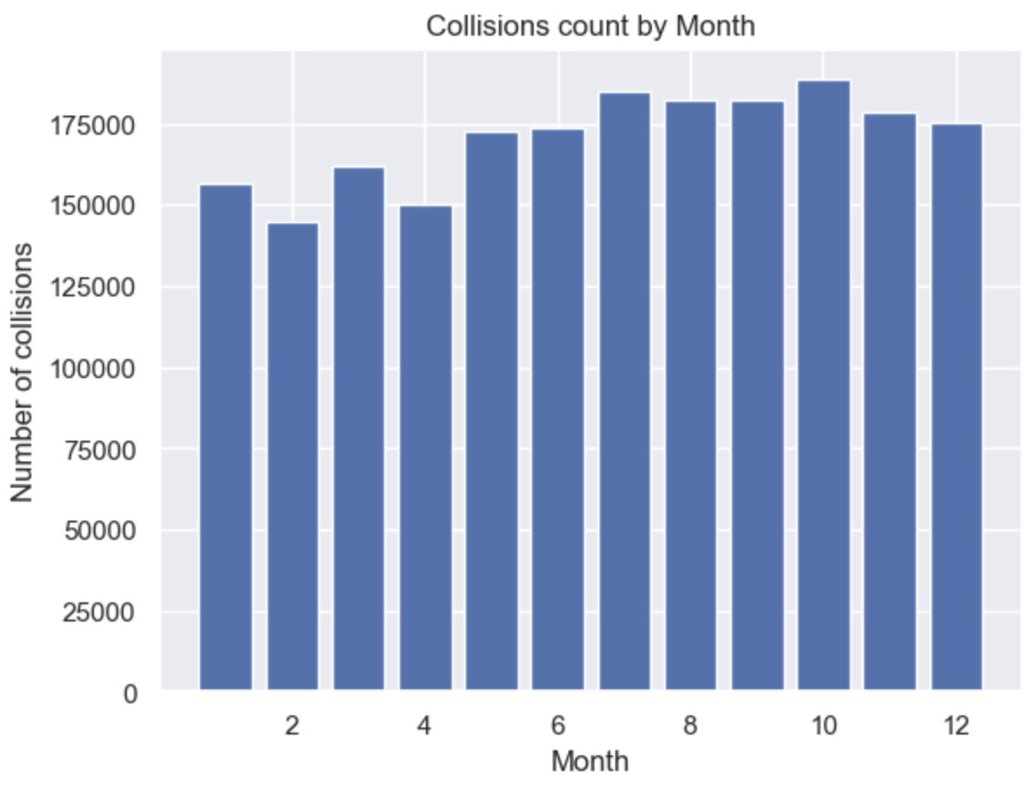

Collisions by the month

Slide 5
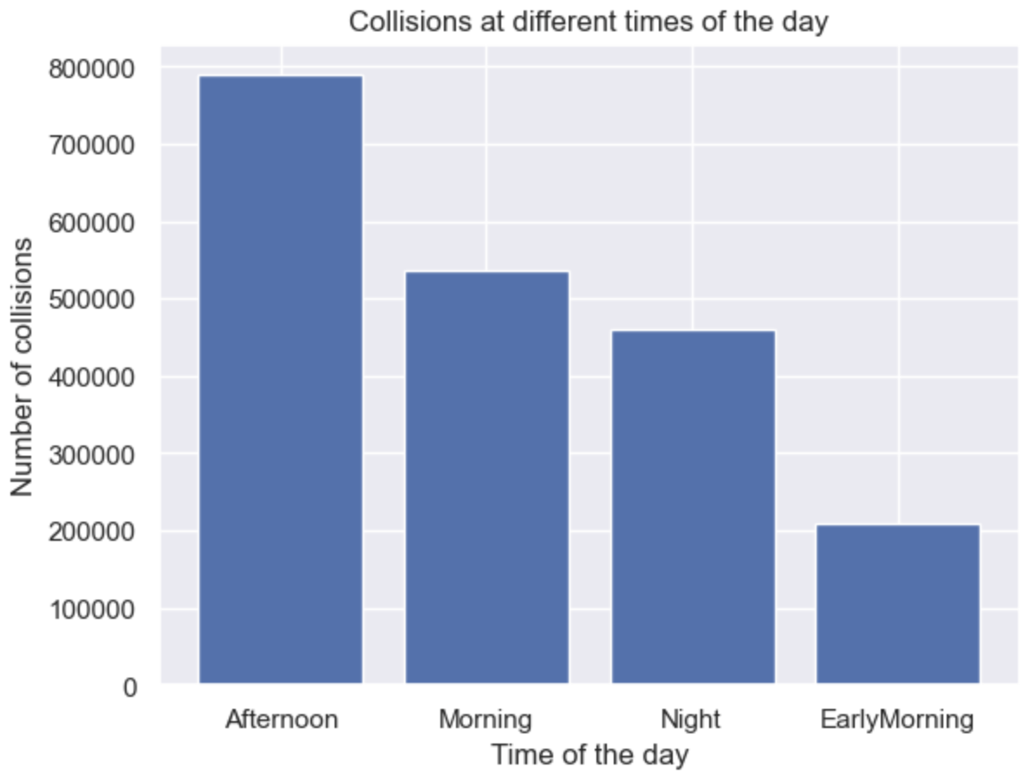
When did most accidents happen in the day?
EarlyMorning Hrs | 00:00-06:00
Morning Hrs | 06:00-12:00
Afternoon Hrs | 12:00-18:00
Night Hrs | 18:00-23:59

Slide 6
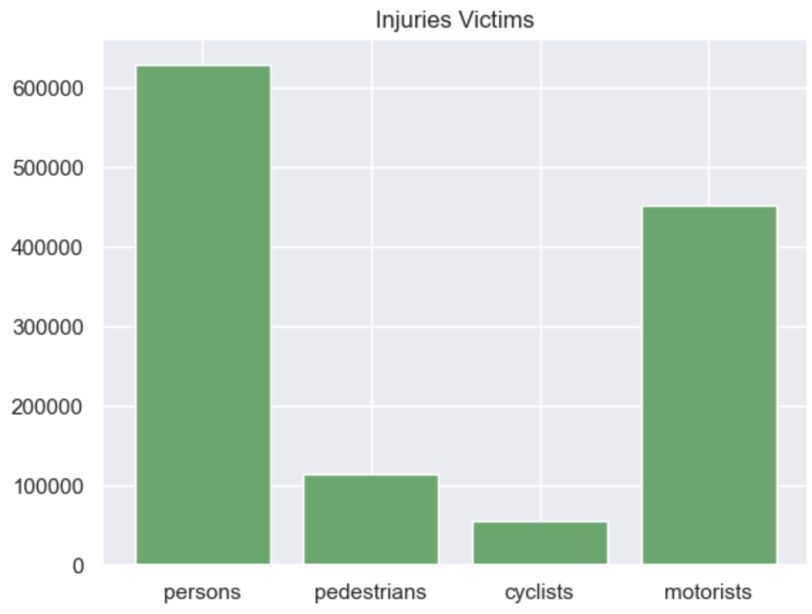
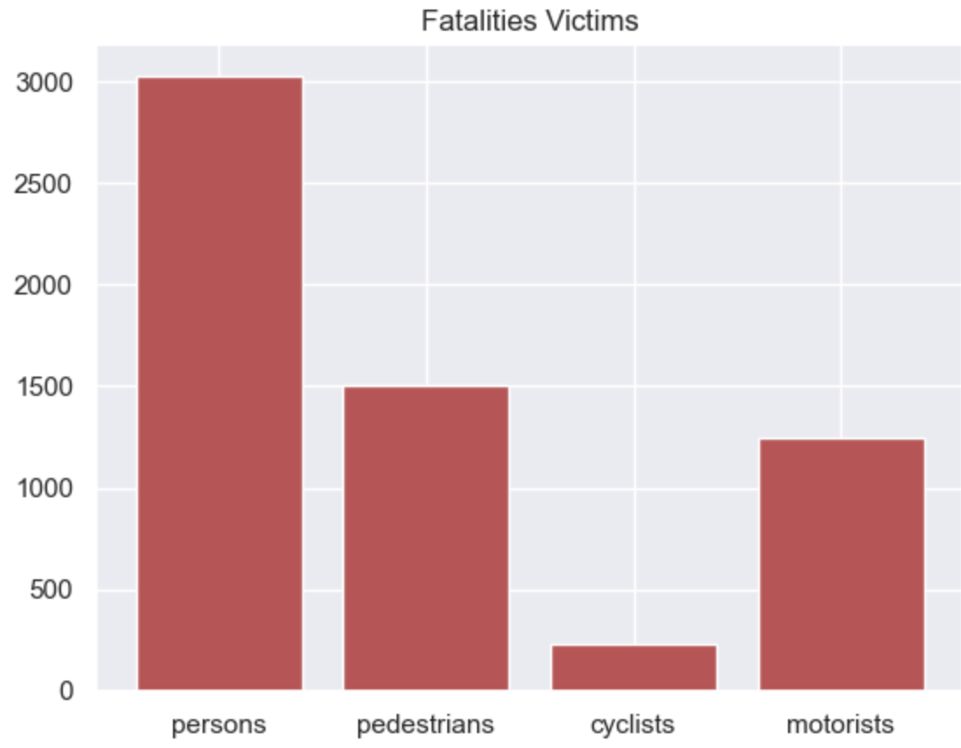
Injuries vs Fatalities

Slide 7
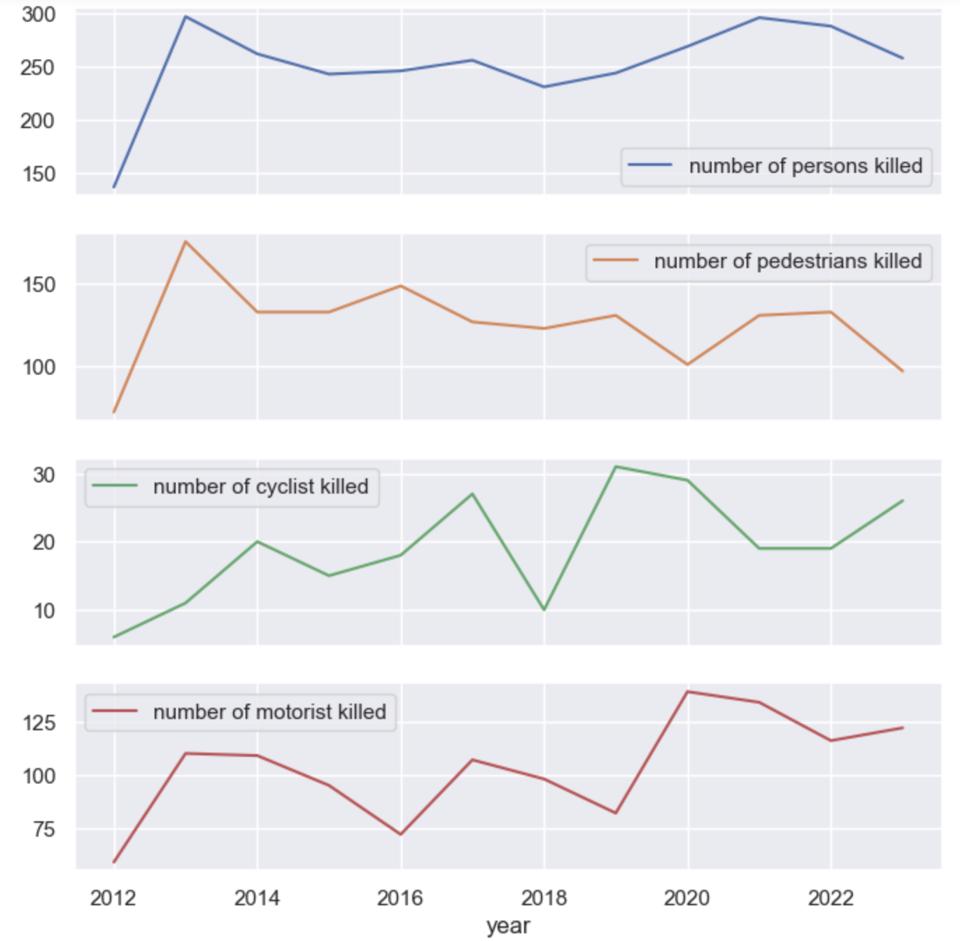
How Are fatalities trending ?

Slide 8
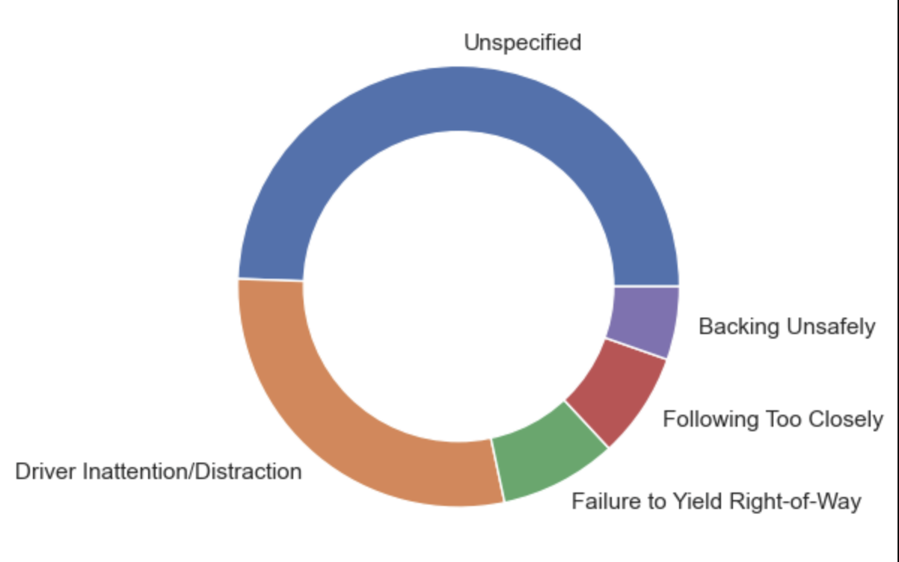
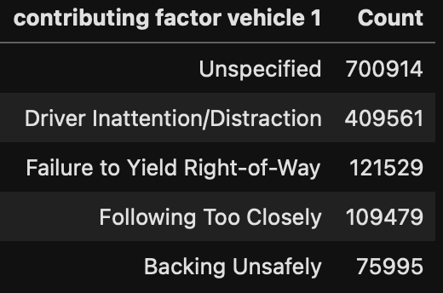
Top 5 factors for collisions

Slide 9
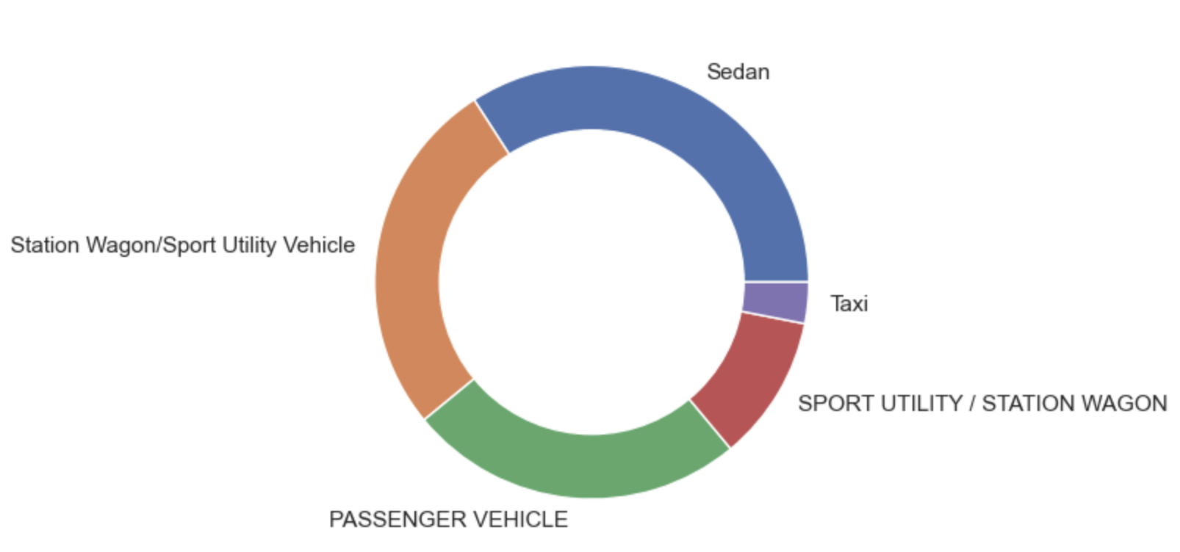
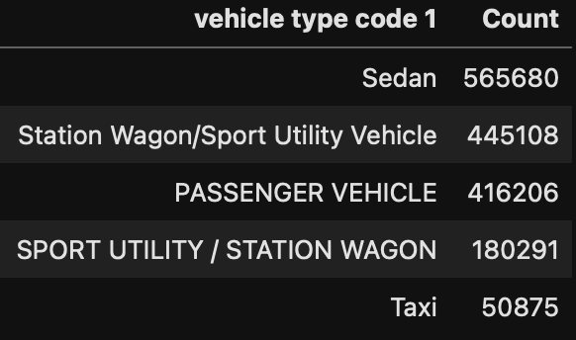
Top 5 vehicle types in collisions

Slide 10
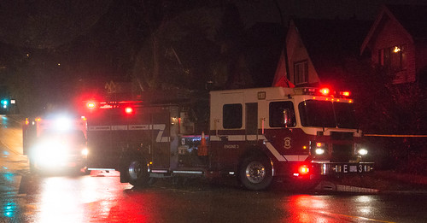
So, what’s the outcome?
Areas for attention:
Persons/pedestrians are major victims for fatalities
Brooklyn, Queens, Manhattan with higher collisions
More drivers during warmer months, so more crashes
Distracted and reckless drivers are the culprits
Sedans, SUVs and passenger vehicles are the problem
NYPD in Action for Safety

